Slide 1
World war 2
(1939-1944)

Slide 2
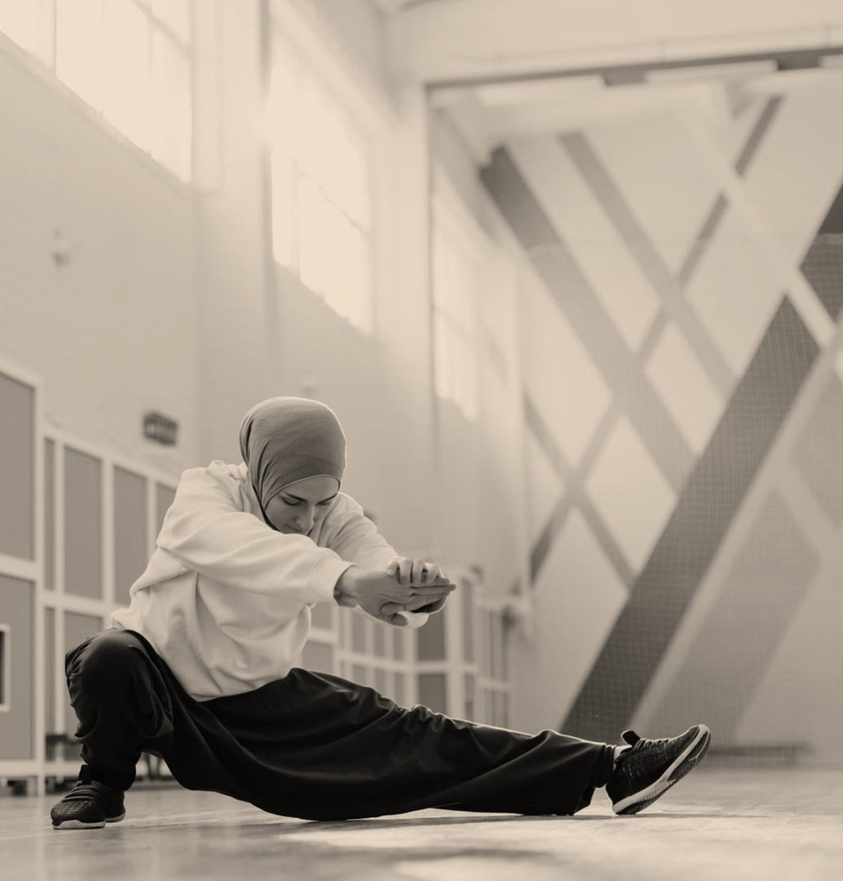
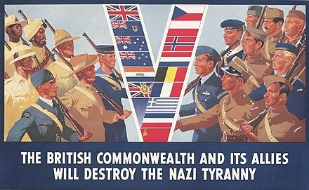
ALLIES
Αυτή η φωτογραφία από Άγνωστος συντάκτης με άδεια χρήσης CC BY-SA

Slide 3
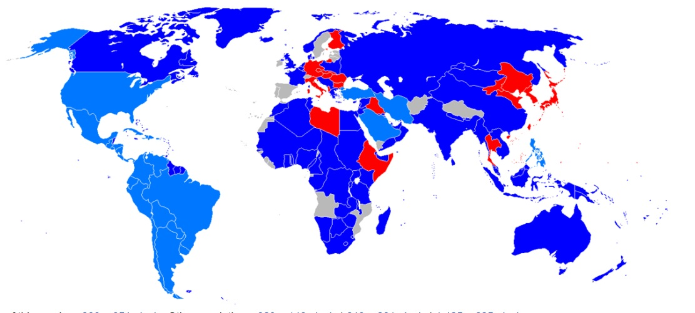
World war 2 – allies world map

Slide 4

Greece

Slide 5

Great BRITAIN

Slide 6
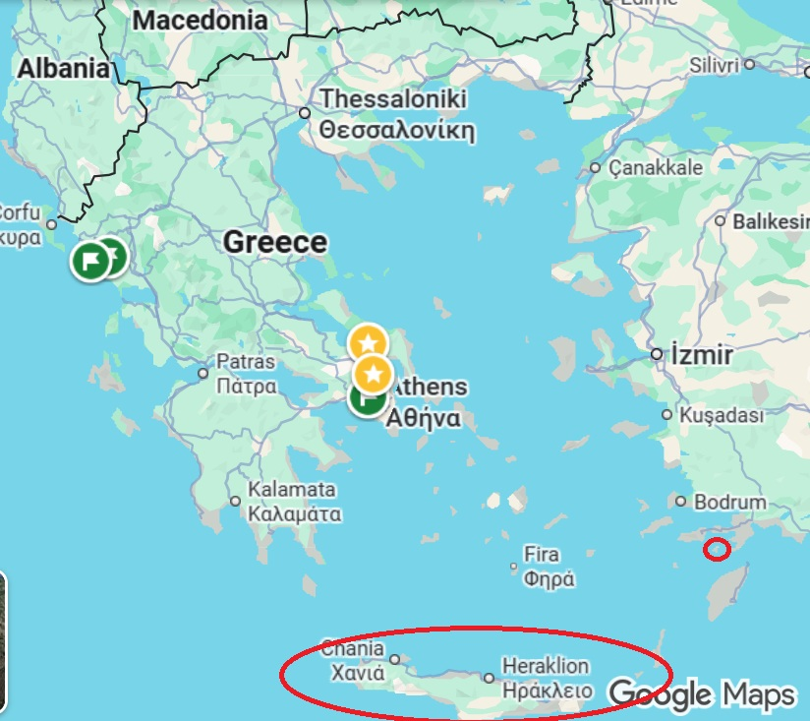
BATTLE OF CRETE (1941) raid on SYMI (1944) - Operation Tenement

Slide 7
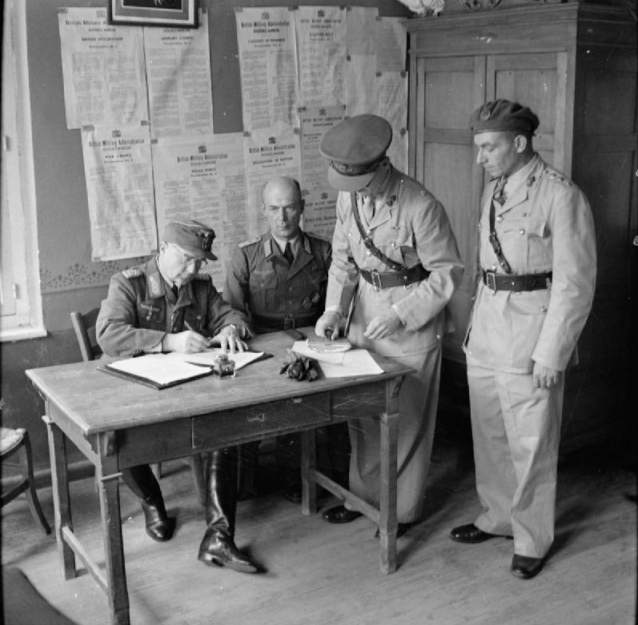
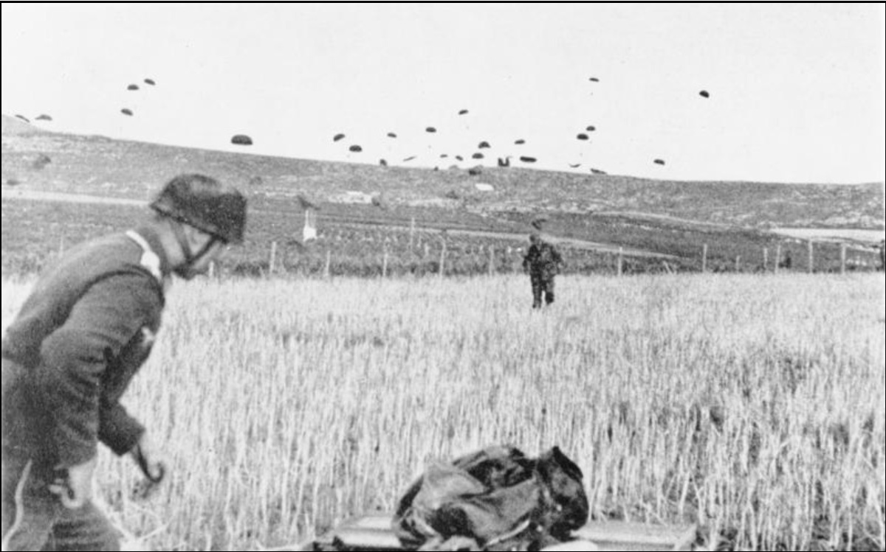
Photos
RAID ON SYMI ( 13-15 JULY 1944)
BATTLE OF CRETE (20th May 1941)
https://en.wikipedia.org/wiki/Battle_of_Crete
https://ww2helmets.com/opening-a-front-in-greece-operation-tenement/

Slide 8
WAR SONGS
coming in on a wing and a prayer
https://www.youtube.com/watch?v=B69CquvLHgY&list=PLCTBQGxjOaqGfZzqBHGLkI9cYaNB1DRES&index=4
Vera Lynn - Wish Me Luck As You Wave Me Goodbye
https://www.youtube.com/watch?v=_bGE8248N7Y&list=PLCTBQGxjOaqGfZzqBHGLkI9cYaNB1DRES&index=10
Spike Jones Der Fuehrer's Face
https://www.youtube.com/watch?v=dZlFBSRrSR0&list=PLCTBQGxjOaqGfZzqBHGLkI9cYaNB1DRES&index=16
1st song about the war:
We're Gonna Hang Out) the Washing on the Siegfried Line
https://www.youtube.com/watch?v=UgXyVL7KgAY&list=PLCTBQGxjOaqGfZzqBHGLkI9cYaNB1DRES&index=1

Slide 9
THANK YOU

